Slide 1

Bias in miRNA enrichment analysis related to gene functional annotations
Karen Guerrero Vazquez Journal Club June 2023

Slide 2



Bias in miRNA enrichment analysis related to gene functional annotations
Authors
Institutions
Konstantinos Zagganas
Thanasis Vergoulis
Georgios K. Georgakilas
Spiros Skiadopoulos
Theodore Dalamagas
University of the Peloponnese
Information Management Systems Institute, “Athena” Research Center
Department of Biology, University of Patras

Slide 3
Is this Paper interesting for you?
miRNA functional enrichment
The standard method for functional enrichment
bias on current standard method
alternative statistical measure

Slide 4
Is this Paper interesting for you?
DIANA-miRPath
miEAA
miRPathDB
MAGIA
Gene Set Enrichment Analysis (GSEA)

Slide 5
miRNA functional enrichment analysis
retrieve a list of all genes targeted by the group of miRNAs
Union
Intersection
retrieve the list of genes that participate in the biological function
perform a statistical test, usually Fisher’s exact test to calculate a p-value that indicates the strength of the association between the miRNA group and the biological function

Slide 6
the standard method of miRNA functional enrichment analysis is not suitable for such analyses

Slide 7
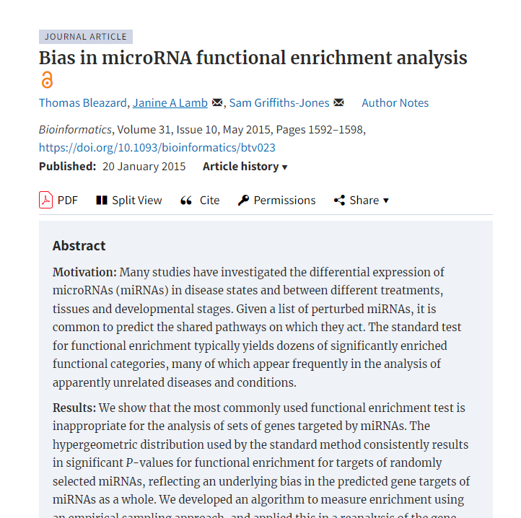
that the standard method of miRNA functional enrichment analysis is not suitable for such analyses
provides highly unspecific results
The mechanics responsible for this bias are not yet fully understood
limited amount of validated positive miRNA:target interactions
virtually non-existent validated negative interactions
Thomas Bleazard et al

Slide 8
most target prediction algorithms have been trained on seed-enriched data sets with features extracted from the sequence surrounding the seed, even though recent evidence shows that non-seed-based interactions are common in miRNA-mediated gene expression regulation

Slide 9
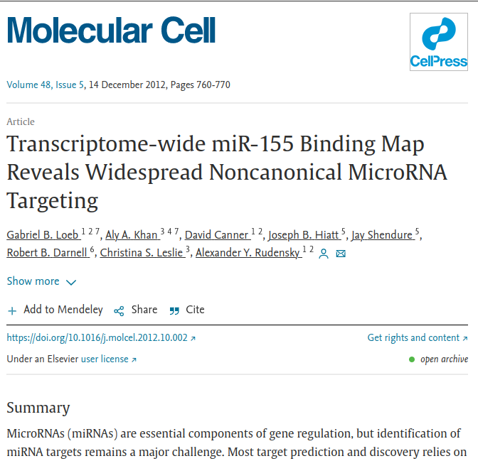
“Recent” evidence
a transcriptome-wide identification of the endogenous targets
miRNA-miR-155
approximately 40% of miR-155-dependent Argonaute binding occurs at sites without perfect seed matches

Slide 10
False Positive Rate
TargetScan: 49%
mirTarBase: 9%
MiRDB: 25%
B3GLCT predictions made by multiple algorithms in miRWalk have a high false positive rate (>96%),

Slide 11
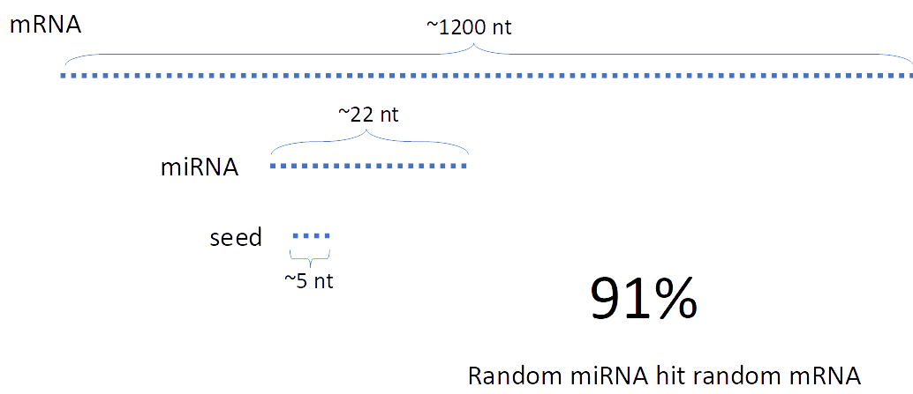

Slide 12
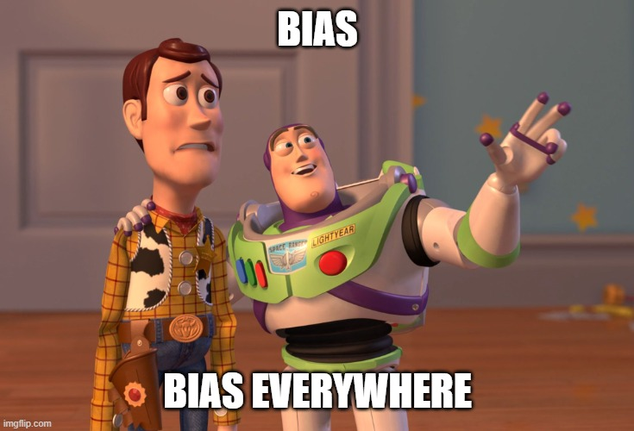
More bias
experimentally validating miRNA binding sites is frequently driven by target prediction algorithms.
Negative results are usually not reported while the published positive interactions are inevitably enriched in seed-based binding type

Slide 13
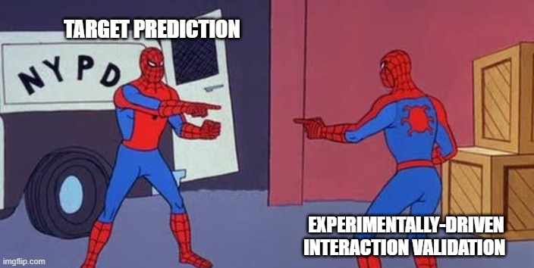
invalidate the assumption made by the hypergeometric distribution:
genes are targeted by miRNAs in a uniform fashion

Slide 14
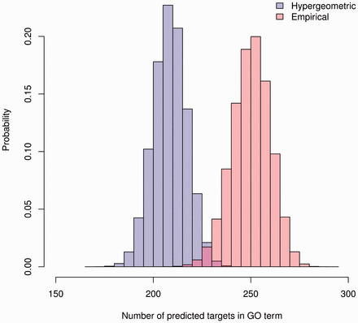
Empirical Distribution
Thomas Bleazard et al

Slide 15
randomization test
Given a miRNA group of interest calculate a statistical measure relevant to the problem.
Create 1 million randomly assembled miRNA groups with the same size as the group of interest and for each of them calculate the same statistical measure.
The empirical p-value is then defined as the proportion of randomly assembled miRNA groups that present a better statistical behaviour compared to the behaviour of the group of interest.
GO term overlap
Thomas Bleazard et al

Slide 16
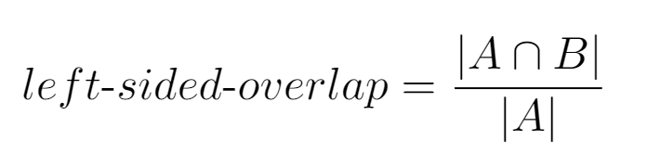
GO term overlap
The proportion of genes targeted by a group of miRNAs, that are also members of a specific GO category
A: set of genes targeted by the group
B: set of genes that participate in the GO category
Thomas Bleazard et al

Slide 17
New Bias On the gene-to-biological-function annotations
reduced sensitivity to false negatives
predicted interactions and gene annotations

Slide 18
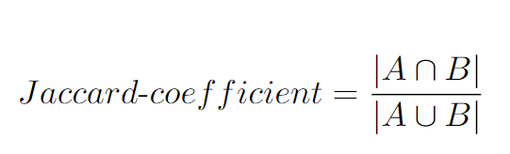
the Jaccard coefficient
A: set of genes targeted by the group
B: set of genes that participate in the GO category

Slide 19
randomized miRNA
1 million randomly assembled miRNA groups
14 miRNAs each.
calculated the gene members intersection
GO category in the data set
targeted by the miRNAs in the group
plotted the expected hypergeometric distribution for the overlaps
number of targeted/non-targeted genes
number of genes belonging/not-belonging to the same GO term
3106 out of a total of 15064 genes are indicated as targets in the set of interactions
expected hypergeometric distribution following

Slide 20
Results
categories that describe more specific biological functions, tend to significantly overlap with the hypergeometric distribution.
categories that present the larger mismatch seem to be those, that contain a large number of genes
mismatch is indeed more prominent as the size of the category increase

Slide 21
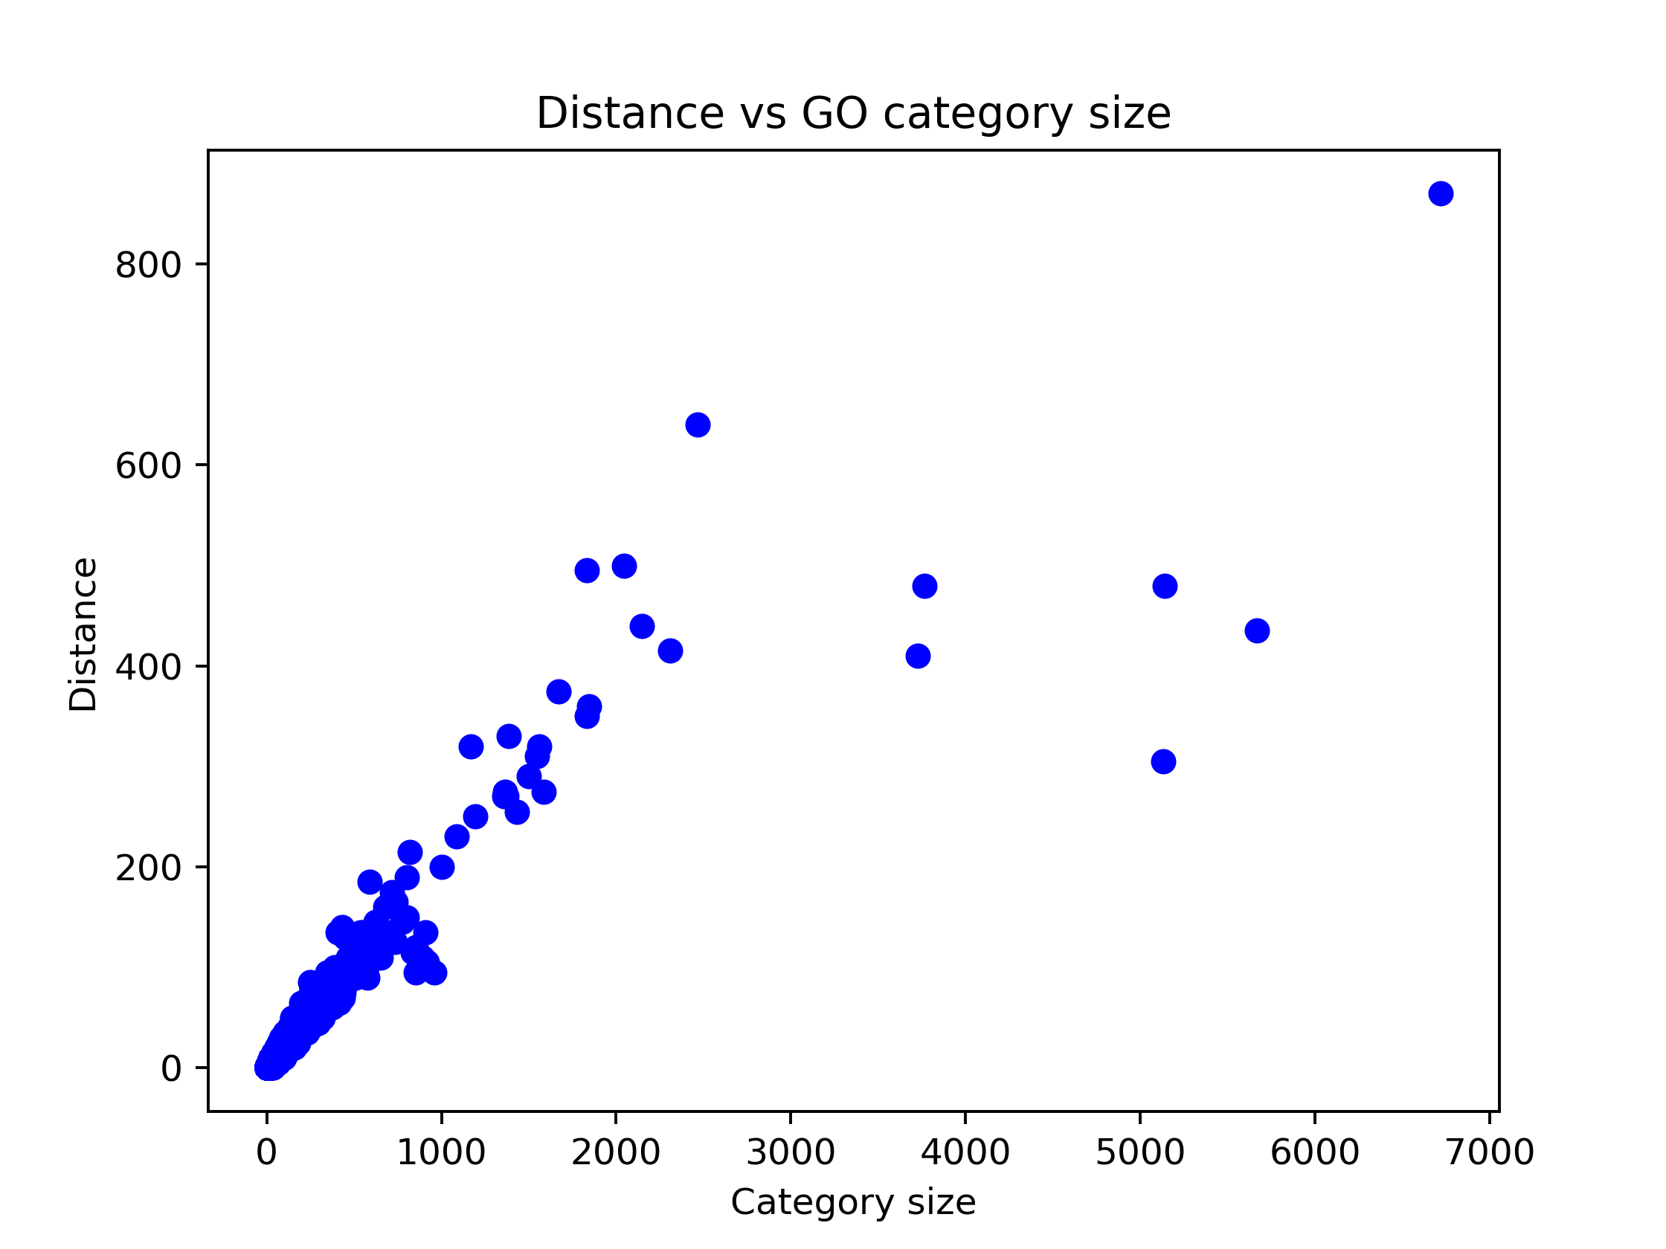
distance between the distributions

Slide 22
The effect is even more pronounced for DisGeNET
and the relationship between the disease size and the distance between the two distribution.
This can maybe be explained by the fact that the text mining tools used to compile the database, utilize structured vocabularies and ontologies.
Thus, the hierarchy existing between the diseases introduces the same bias as seen for GO.
KEGG has the same effect. This could maybe be attributed to complex interactions between genes in pathways that are not specified in the data set.

Slide 23
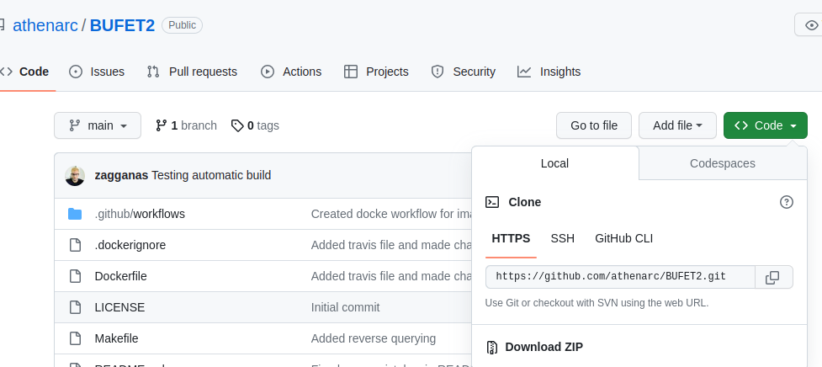
BUFET2

Slide 24
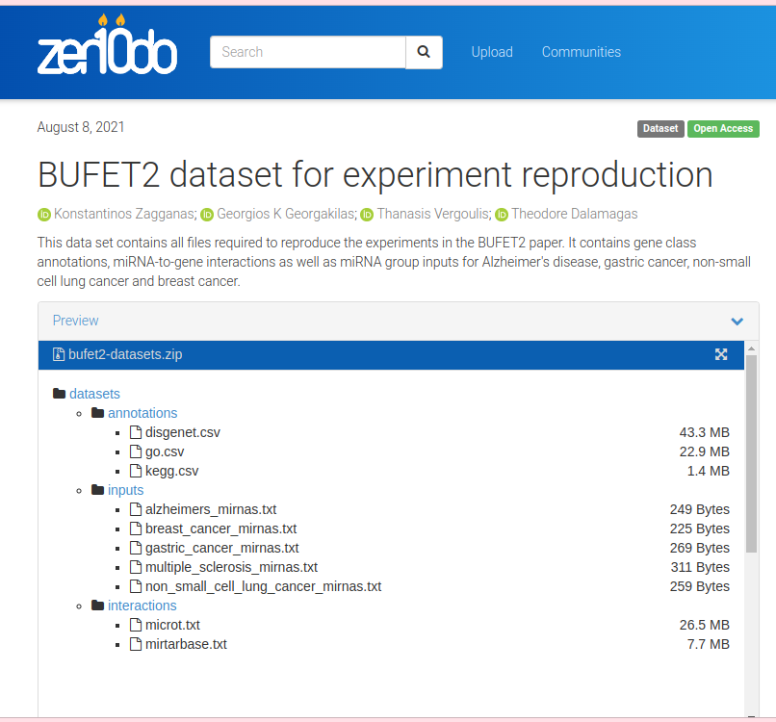
Example Data

Slide 25
Running BUFET2
python3 bufet2.py -miRNA microRNA_list.txt -interactions microRNA:Target_interactions.txt -annotations functional_annotations.csv -iterations 1000000 -output output_file.txt --no-synonyms

Slide 26
Running BUFET2
python3 bufet2.py -miRNA /data/datasets/inputs/alzheimers_mirnas.txt -interactions /data/datasets/interactions/mirtarbase.txt -annotations /data/datasets/annotations/kegg.csv -iterations 1000000 -output /data/outputs/output_alz.txt --no-synonyms

Slide 27
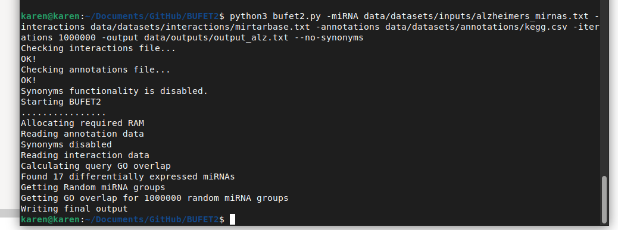
In Console

Slide 28
Output
#GO-term-ID | GO-term-size | Observed-Target-Left-Sided... | Mean-Random-Simulated-Left... | Left-sided-empirical-p-value | Observed-Target-Two-Sided... | Mean-Random-Simulated-Two... | Two-sided-empirical-p-value
hsa04974~Protein digestion and absorption | 103 | 0.003261 | 0.004142 | 0.739577 | 0.003189 | 0.003946 | 0.715527
hsa04971~Gastric acid secretion | 76 | 0.004014 | 0.005203 | 0.800503 | 0.003955 | 0.005029 | 0.782733
hsa04966~Collecting duct acid secretion | 27 | 0.001756 | 0.001667 | 0.429571 | 0.001747 | 0.001647 | 0.424004

